Slide 1
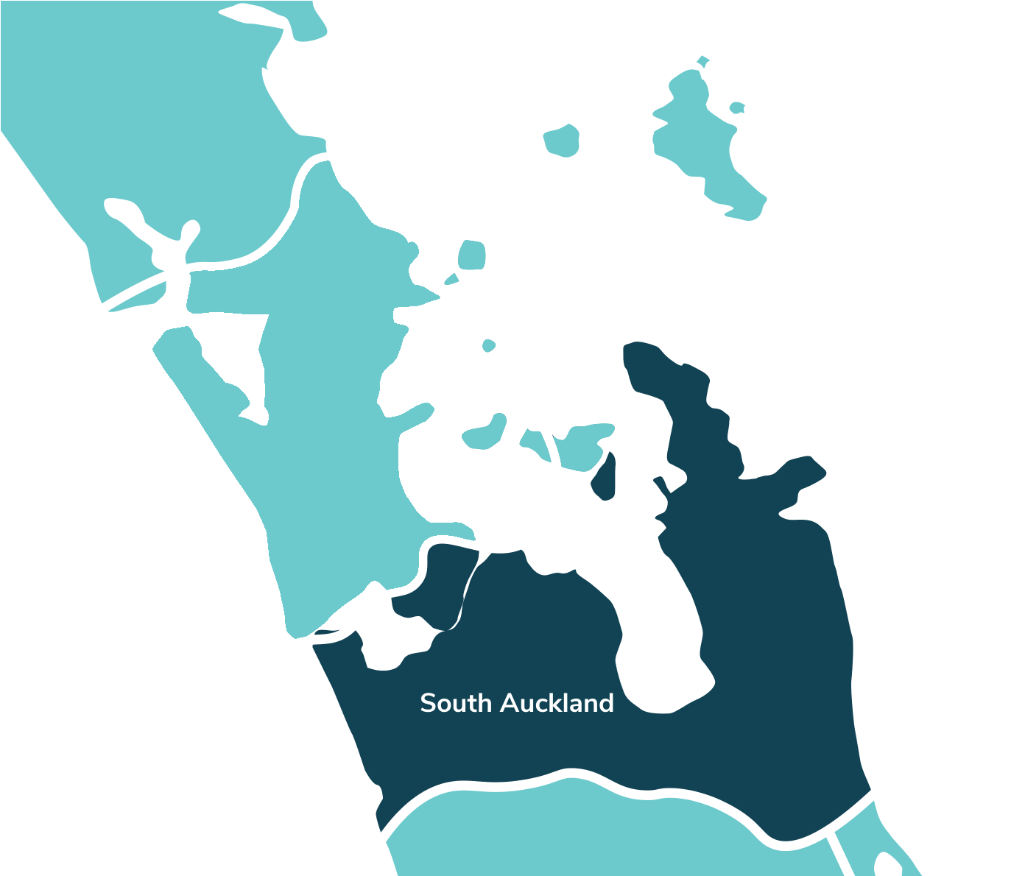



South
Auckland
Security issues
in the community
Cherie, Jessie & Dharshna

Slide 2
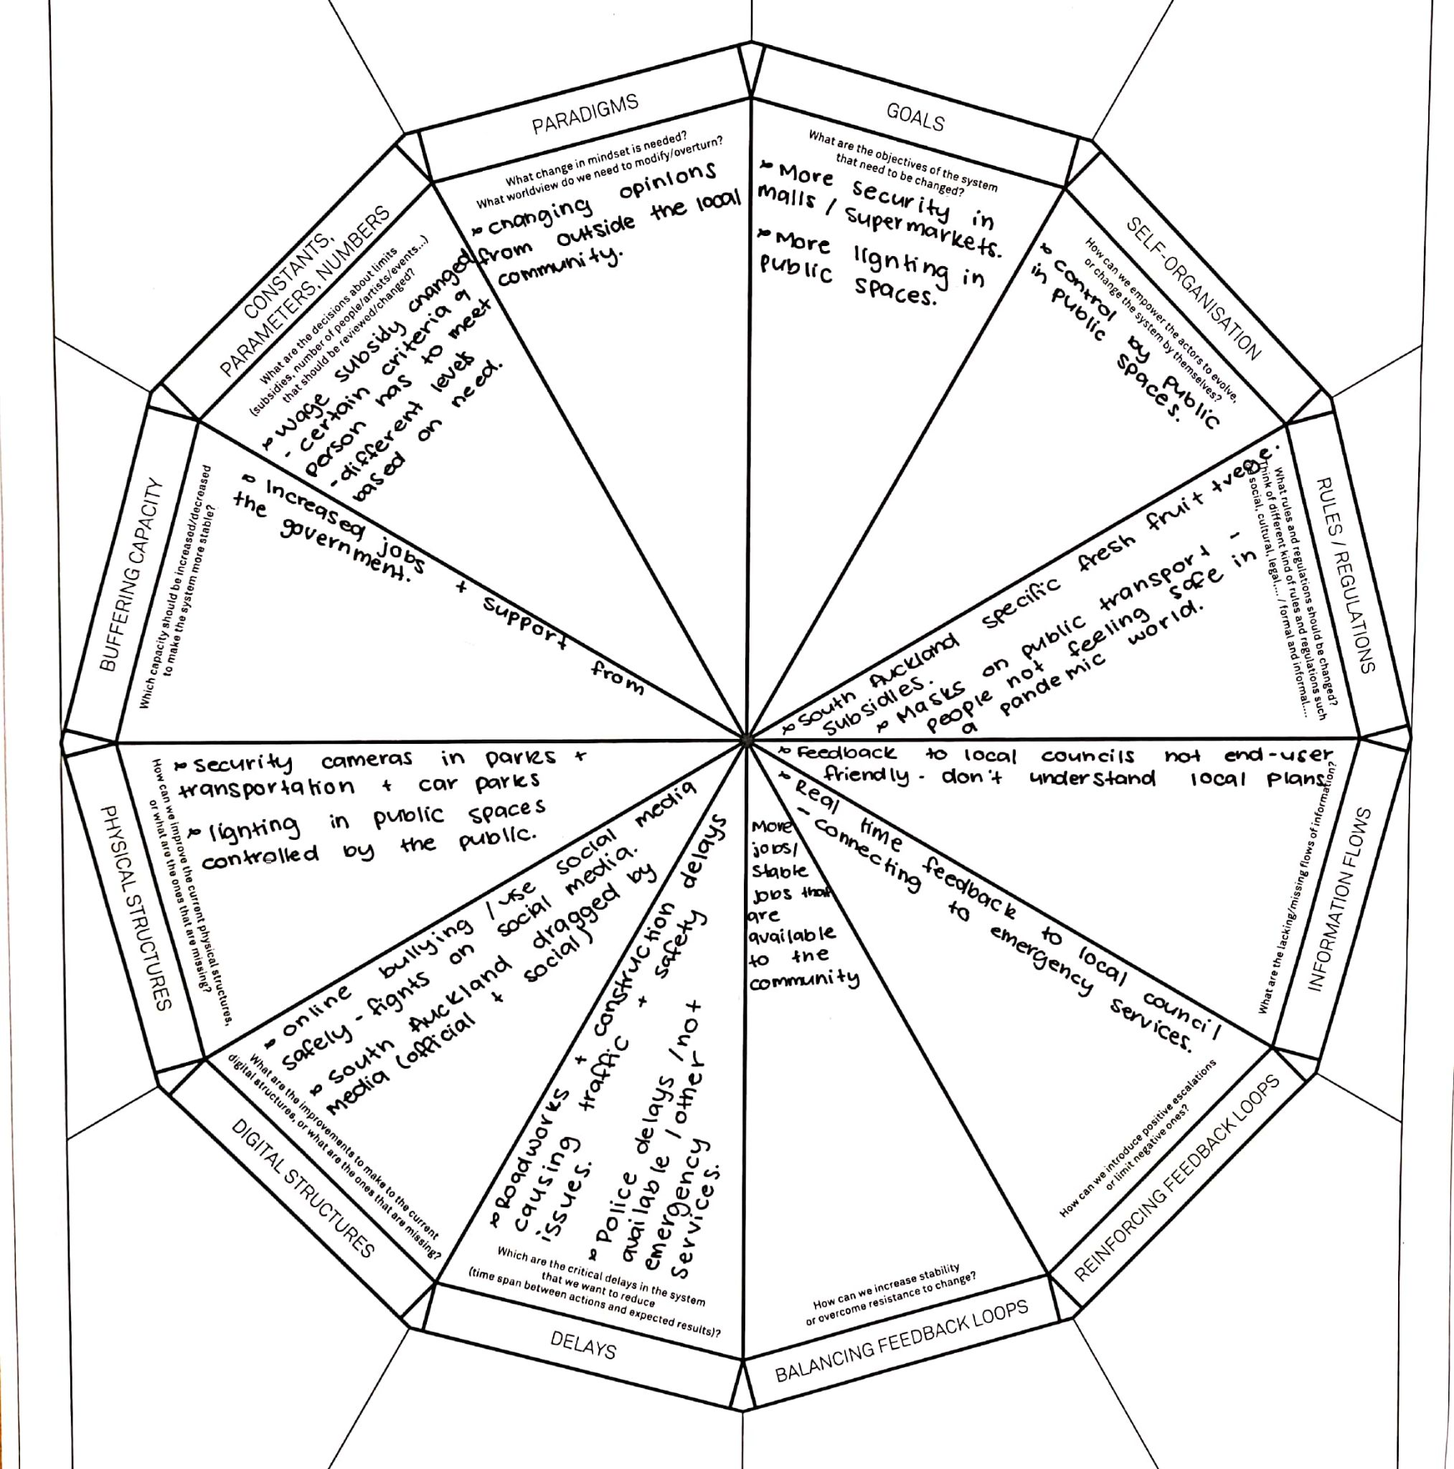
Exploring the space of possibilities
Goals: More security in malls/supermarkets
Physical Structures: Security cameras in parks, transportation, car parks. And more lighting in public spaces.
Buffering Capacity: Increase jobs & support from the government
Delays: Improve emergency delays (police, ambulances & firefighters).
Rules/Regulations: Masks on Public Transport (people not following).

Slide 3
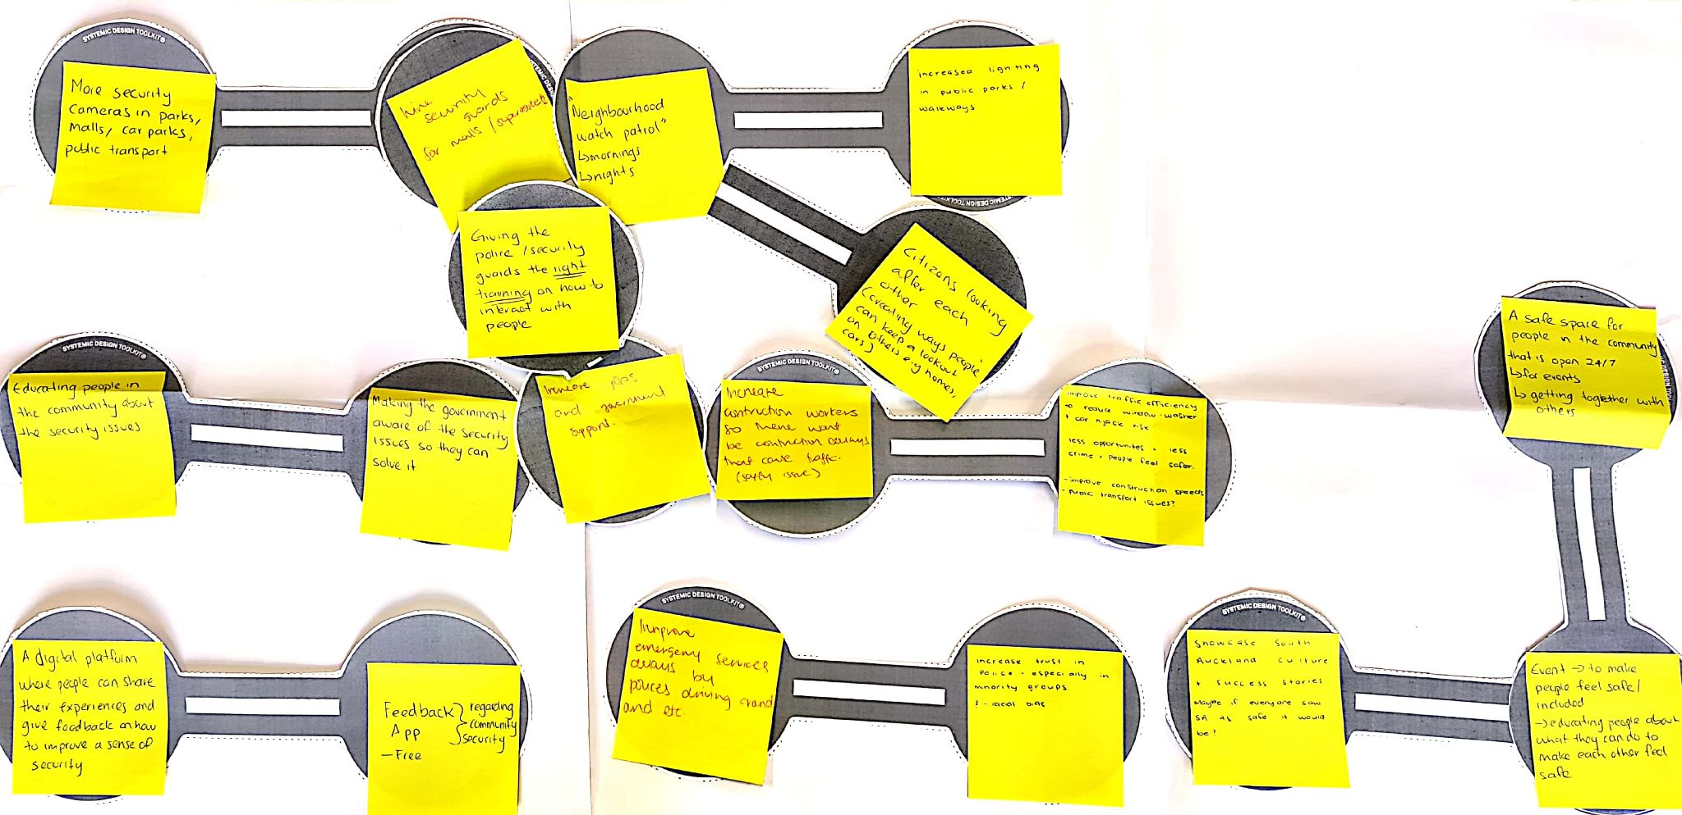
Designing the intervention model
Main Interconnecting Circles: We started with one group of connecting circles focusing on security, and how increasing security and public lighting in South Auckland will reduce crime and increase jobs

Slide 4
Designing the intervention model
Secondary Interconnecting Circles: We connected a potential app with a digital platform for people to share their experiences, as well as connecting improved emergency services with improved traffic + congestion. Finally we connected a safe place for people in the community withevents to make people feel safe and included as well as with showcasing South Auckland and their success stories.

Slide 5
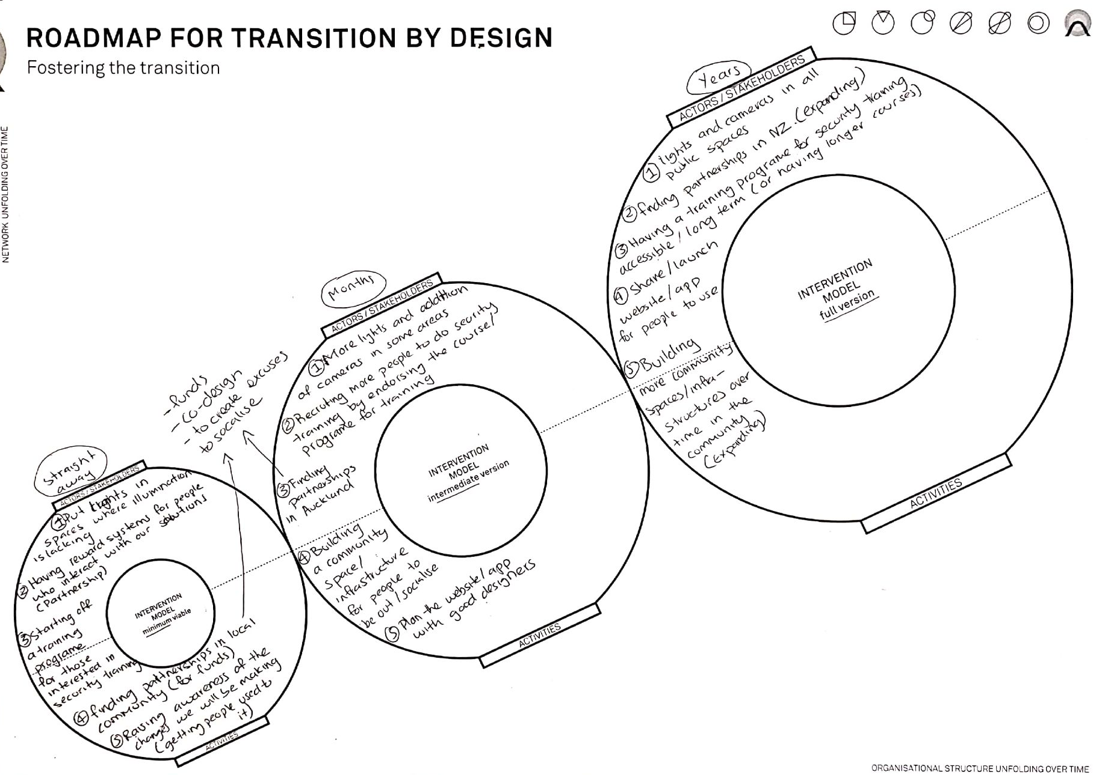
Fostering the Transition
Proposed intervention…..
Our solution to the security issues in our community will be implemented over time, we realise that this is an issue that comes with many aspects and cannot be solved straight away.
We will implement the solutions that we think are necessary and are urgently needed, then put other solutions into action over time to tackle the security issues in our community.

Slide 6

Thank You!

